Slide 1
INTRODUCTION
- JAVA (Part 1)
(Module 1)-
Prepared by Renetha J.B.(LMCST)

Slide 2
Topics
Java programming Environment and Runtime Environment,
Development Platforms
Standard, Enterprise.
JVM
Java compiler,
Bytecode

Slide 3
Java
Developed by James Gosling from Sun Microsystems in
1991.
This language was initially called “Oak,” but was renamed “Java” in 1995.
The target of Java is to write a program once and then run this program on multiple operating systems. (WORA)
Java is a programming language
It has compiler, core libraries and a runtime (Java virtual machine(JVM)).

Slide 4
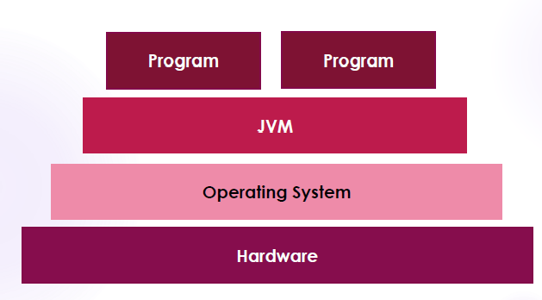

Slide 5
JVM
A Virtual Machine is a virtual representation of a physical computer.
JVM is the Java run-time system.
Java Virtual Machine is called virtual because it provides a machine interface that does not depend on the operating system and machine hardware architecture.
So Java programs are WORA (Write Once Run Anywhere)p rograms.
Java is Platform Independent, JVM is Platform Dependent

Slide 6
JVM(contd.)
When we compile a Java program, we get .class file(bytecode) which is not executable.
JVM interprets the .class file into machine code depending on the operating system and hardware.
JVM executes java programs like a machine.
JVM is also responsible for garbage collection, array bond checking etc.
JVM is platform indepenedent.

Slide 7
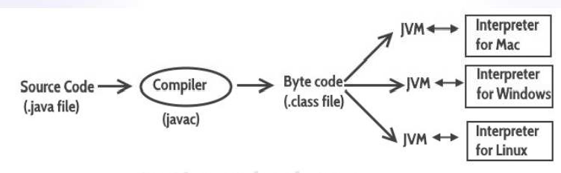

Slide 8
JRE
It is an installation package which provides environment to only run (not develop)the java program (or application) onto your machine.
JRE is only used by END-USERS of the system who only wants to run the Java programs
The JDK, along with the Java Virtual Machine (JVM) and the JRE, can be used by developers to program and run Java applications.

Slide 9
JDK
The Java Development Kit (JDK) is a software development environment used for developing Java applications.
It includes
The Java Runtime Environment (JRE)
An interpreter/loader (Java)
A compiler (javac)
An archive (jar)
A documentation generator (Javadoc)
Other tools needed in Java development.

Slide 10
JDK
JDK provides the environment to develop and execute(run)the Java program.
JDK is a kit(or package) which includes two things
Development Tools(to provide an develop your java programs)
JRE (to execute your java program).
environment to
JDK is used by Java Developers.

Slide 11
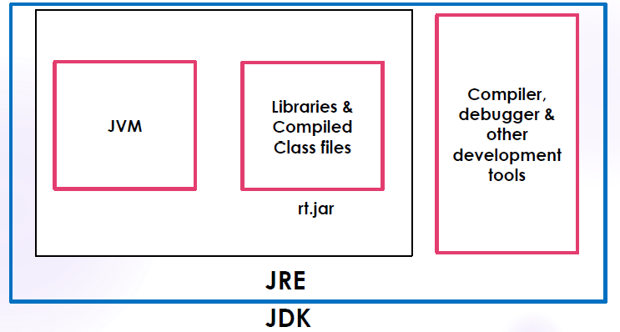
Jvm jre jdk

Slide 12
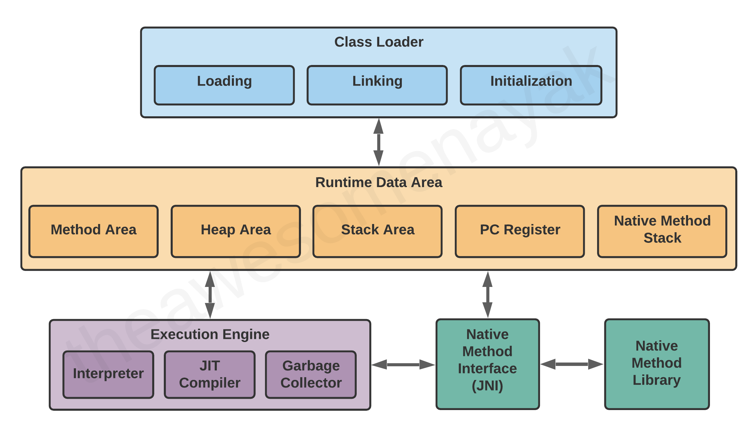
JVM - Components

Slide 13
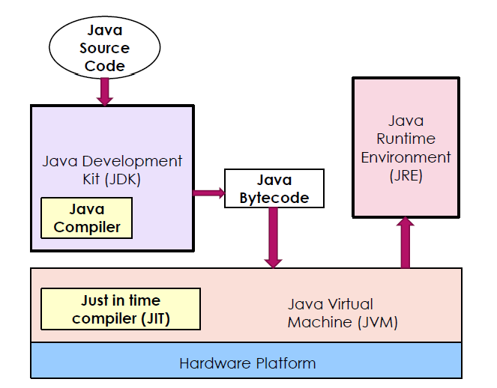
Interaction between JDK and JRE

Slide 14
Java Programming Environment
Java is a concurrent, class-based, object-oriented programming and runtime environment, consisting of
A programming language
An API specification
A virtual machine specification

Slide 15
Development Platforms
All Java platforms consist of a Java Virtual Machine (JVM) and an Application Programming interface (API).
The Java Virtual Machine is a program, for a particular hardware and software platform, that runs Java technology applications.
An API is a collection of software components that you can
use to create other software components or applications.

Slide 16
Development Platforms
Java development platform is a particular environment in which Java programming language applications run.
Java Platform, Standard Edition (Java SE)
Java Platform, Enterprise Edition (Java EE)
Java Platform, Micro Edition (Java ME)
Java FX

Slide 17
Development Platforms - Standard Edition
When most people think of the Java programming language, they think of the Java SE (Standard Edition) API.
Java SE's API provides the core functionality of the Java
programming language.
It defines everything from the basic types and objects of the Java programming language to high-level classes for networking, security, database access, graphical user interface (GUI) development, and XML parsing.
Java SE platform consists of a virtual machine, development tools, deployment technologies, and other class libraries and toolkits commonly used in Java technology applications.

Slide 18
Development Platforms –Enterprise Edition
The Java EE (Enterprise Edition) platform is built on top of the Java SE platform.
The Java EE platform provides an API and runtime environment for developing and running large-scale, multi-tiered, scalable, reliable, and secure network applications.

Slide 19
Development Platforms –Micro Edition
The Java ME platform provides an API and a small-
footprint virtual machine for running programming language applications on devices, like mobile phones.
Java small
This API is a subset of the Java SE API, along with special class libraries useful for small device application development.

Slide 20
Development Platforms –Java FX
Java FX technology is a platform for creating rich internet applications written in Java FX Script.
Java FX Script is a statically-typed declarative language that is compiled to Java technology bytecode, which can then be run on a Java VM.

Slide 21
Java Compiler
A Java compiler is a compiler for the Java programming language.
Java programs are compiled using javac command.
Command for compilation
javac Programname.java
The output of compiling the java code is not executable code. It is called bytecode (Programname.class)

Slide 22
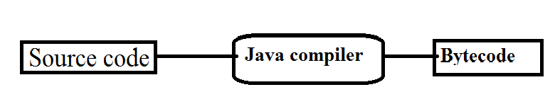
Program.java
Program.class

Slide 23
Java’s Magic: The Bytecode
The output of compiling the java code is not executable code. It is called bytecode.
Bytecode is a highly optimized set of instructions designed to be executed by the Java run-time system, which is called the Java Virtual Machine (JVM).
JVM was designed as an interpreter for bytecode.
Bytecode is a class file.

Slide 24
Bytecode(contd.)
Translating a Java program into bytecode makes it much easier to run a program in a wide variety of environments because only the JVM needs to be implemented for each platform. - PORTABILITY
Although the details of the JVM will differ from platform to platform, all JVM understand the same Java bytecode.
Bytecode has been highly optimized, so the use of bytecode enables the JVM to execute programs much faster.(eventhough compilation and interpretation is needed)

Slide 25
Bytecode(contd.)
When a JIT(Just In Time) compiler is part of the JVM, selected portions of bytecode are compiled into executable code in real time, on a piece-by-piece, demand basis.
JIT compiler compiles code as it is needed, during execution.
Not all sequences of bytecode are compiled—only codes that will benefit from compilation.
The remaining code is simply interpreted.
Java is a compiled interpreted language.

Slide 26
Bytecode(contd.)
Java bytecode is the intermediate representation of your Java program that contains instructions that Java Virtual Machine will execute.
Thus, the output of javac is not code that can be directly executed.

Slide 27
REFERENCE
Herbert Schildt, Java: The Complete Reference, 8/e, Tata McGraw Hill, 2011.

